Slide 1


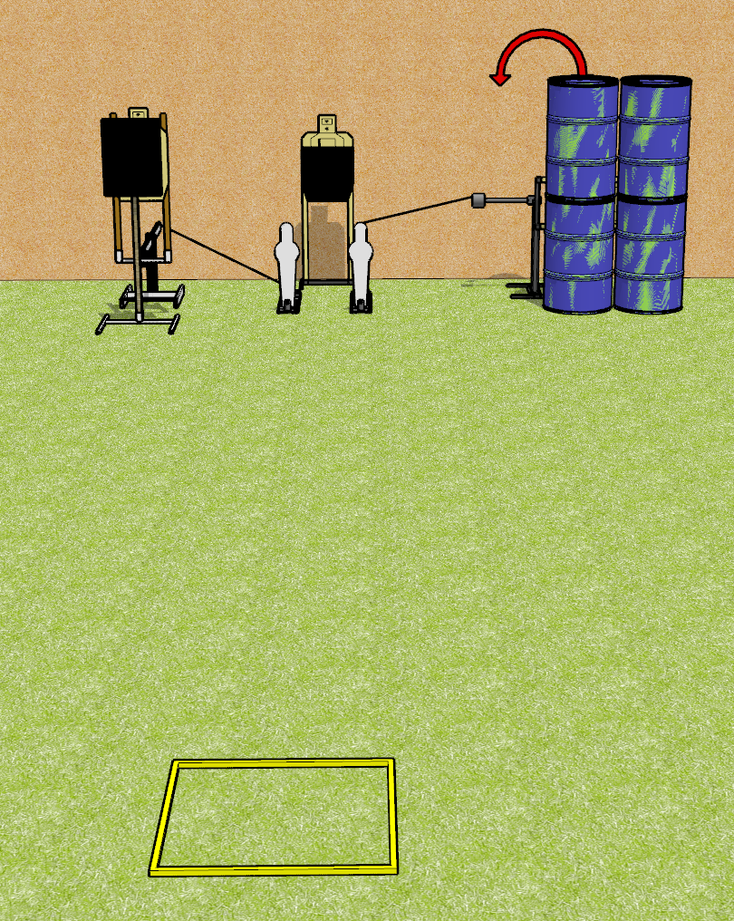
 | Dothan Gun Club – USPSA Match Bob It Course Designer : Drew Coleman
Round Count 8 Rounds 3 USPSA 2 Mini poppers
Equipment List 1 bobber + steel challenge plate and stand + activator 1 swinger + activator Shooting box

Slide 2
Bob It
Written Stage Briefing
Bob It is an 8 round, 40 point, Comstock speed shoot. There are 3 USPSA targets and 2 mini poppers. The best 2 hits on paper will score, and steel must fall to score. The start signal is audible.
The left popper activates the bobber which is a disappearing target. The right popper activates the swinger which remains visible at rest.
Handgun start position is in shooting box, wrists below belt. Handgun is loaded and holstered.
PCC start position is in shooting box, stock on belt. Carbine is loaded, safety on.
On start signal, engage targets as they become available from within the shooting area.

